Slide 1

Cereal Grain Data Acquisition
University of Idaho
Ryan Donahue
Kennedy Caisley

Slide 2
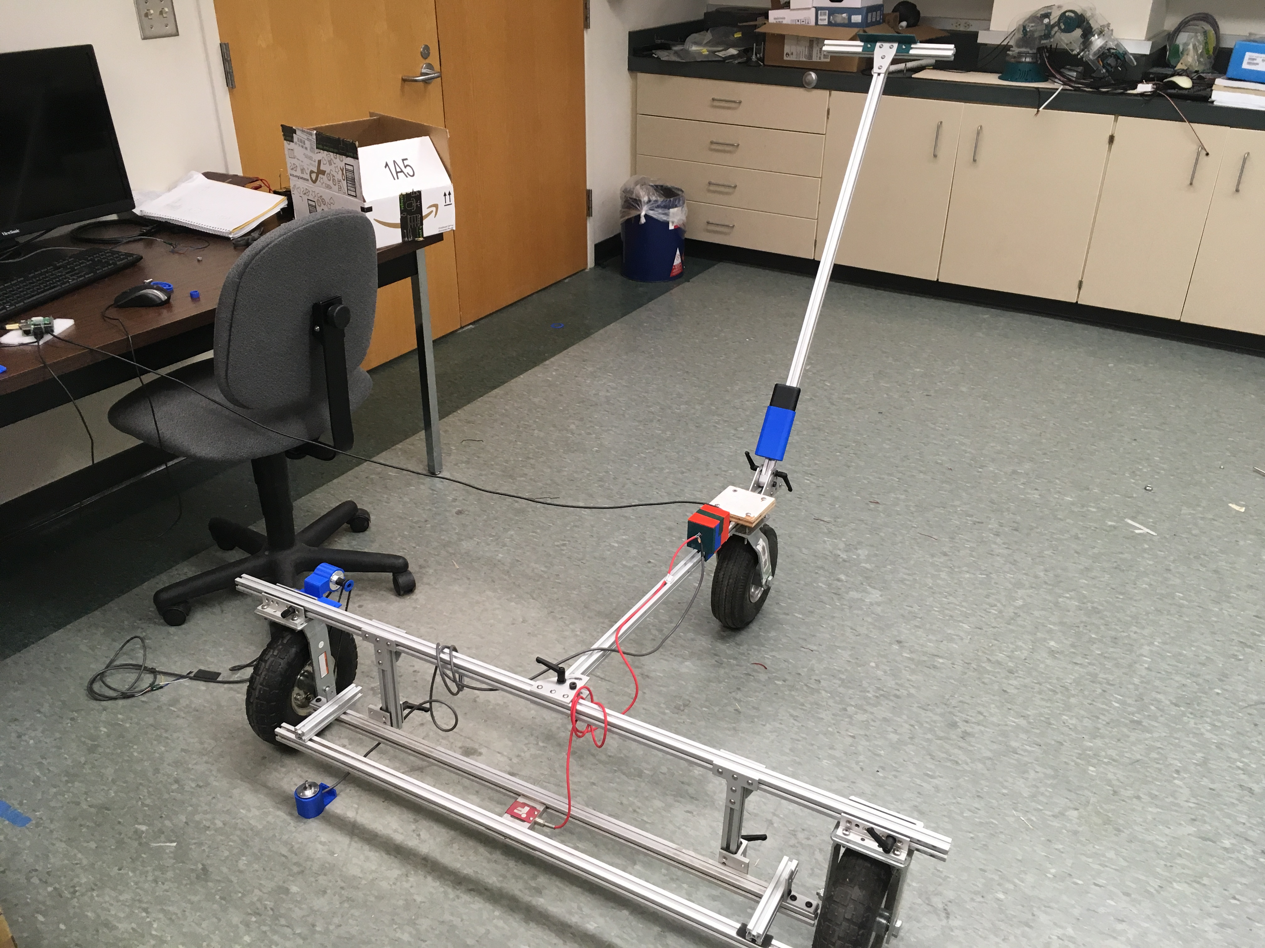
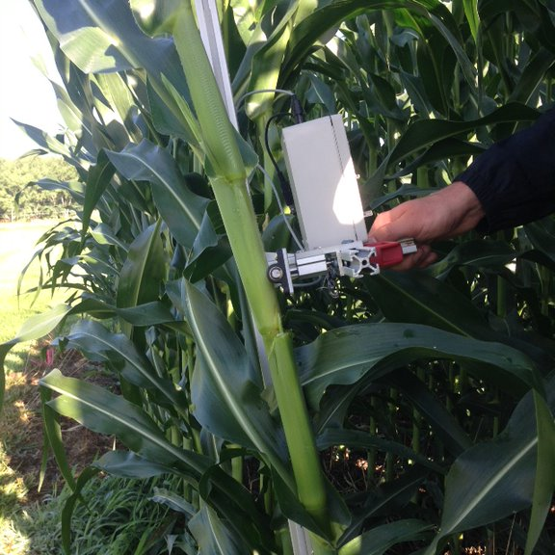
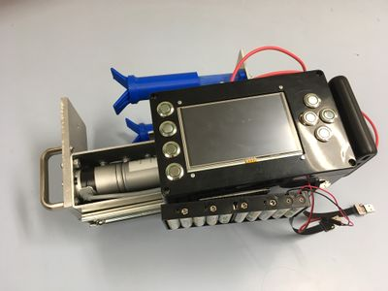
Project Scope

Slide 3
Objective:
Create an integrated device that:
Reduces $515 BOM cost for each unit
Improves data collection rate
Improves device reliability
Adds new functionality
Can be manufactured and assembled by outside vendor
While maintaining:
Functionality of current devices
Operation of the GUI
Flexibility of device

Slide 4
Required Features
Meet/Exceed Existing Device
Precision ADC
Linear actuator
Linear encoder
Accelerometer
Temperature sensor
Humidity sensor
Rotary encoder
LCD display
GPS receiver
Data transfer
Add/Improve
Improve data acquisition rate
Add barcode scanner
Add touch screen
Reduce manufacture time
Reduce cost

Slide 5
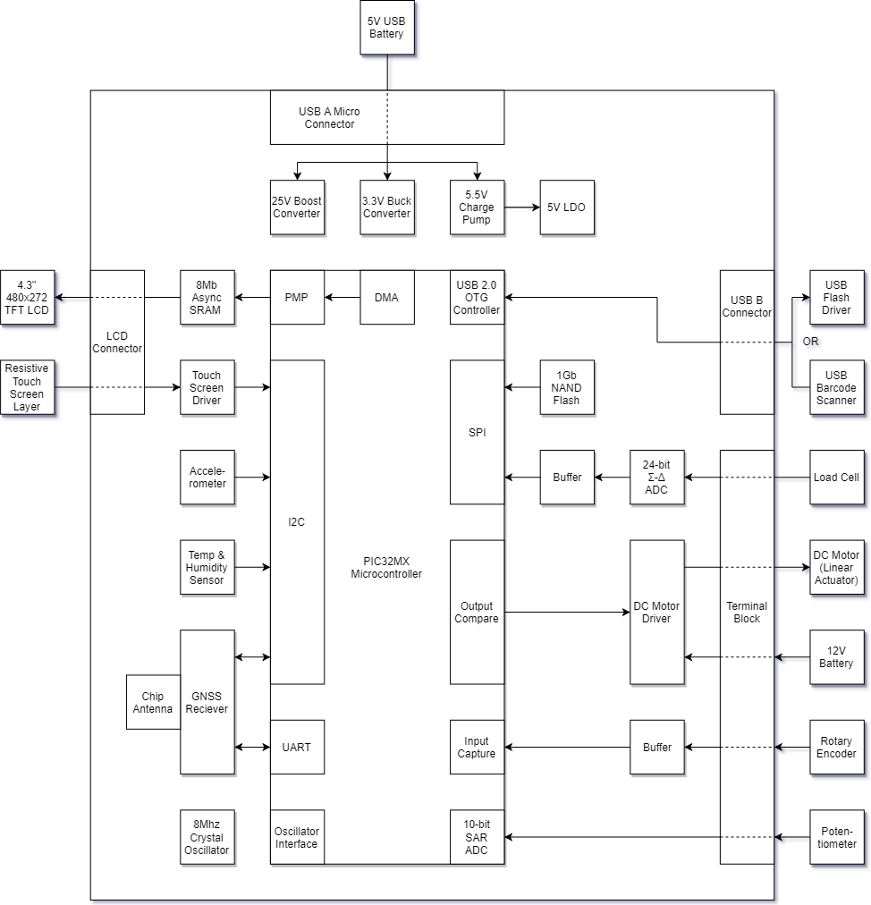

Slide 6
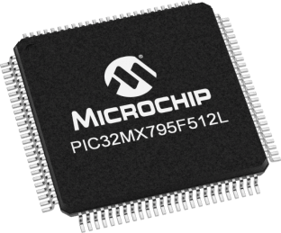

Slide 7
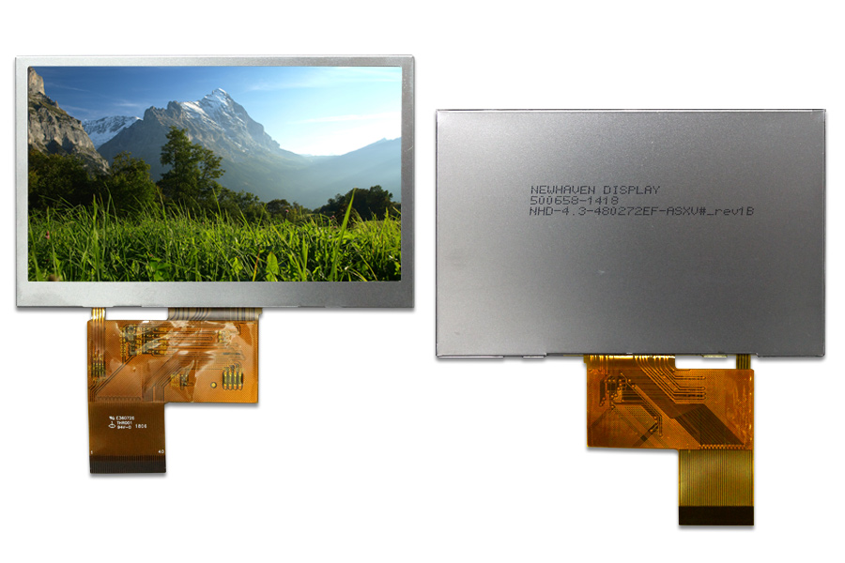

Slide 8
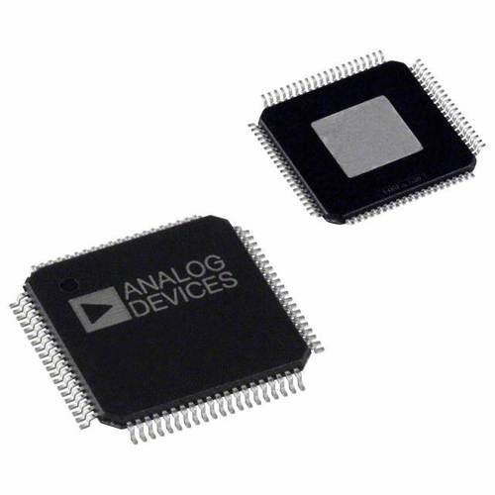

Slide 9
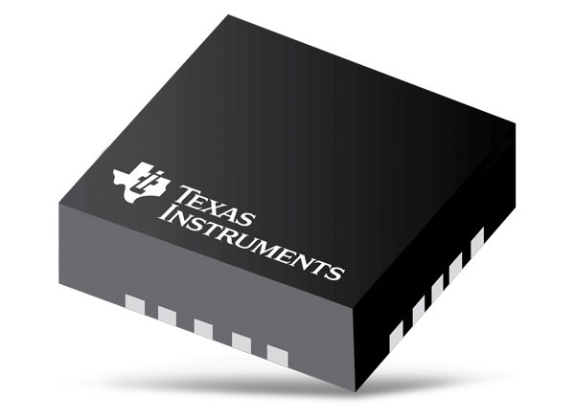

Slide 10
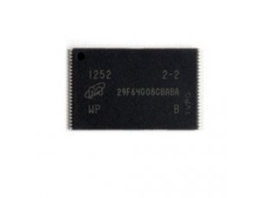

Slide 11
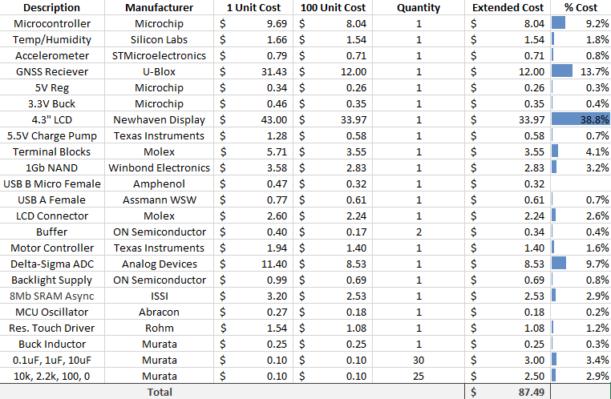
Per Unit Device Cost
PCB Fab &
SMT Assembly
≈ $5.25
Case Fab ≈ $5.00

Slide 12
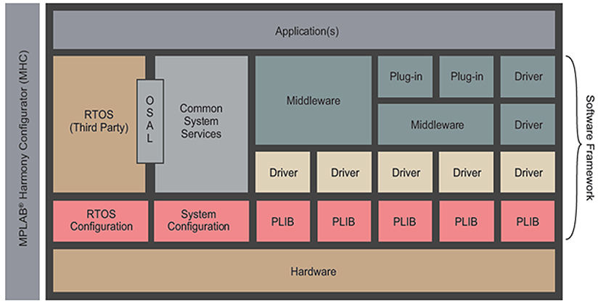
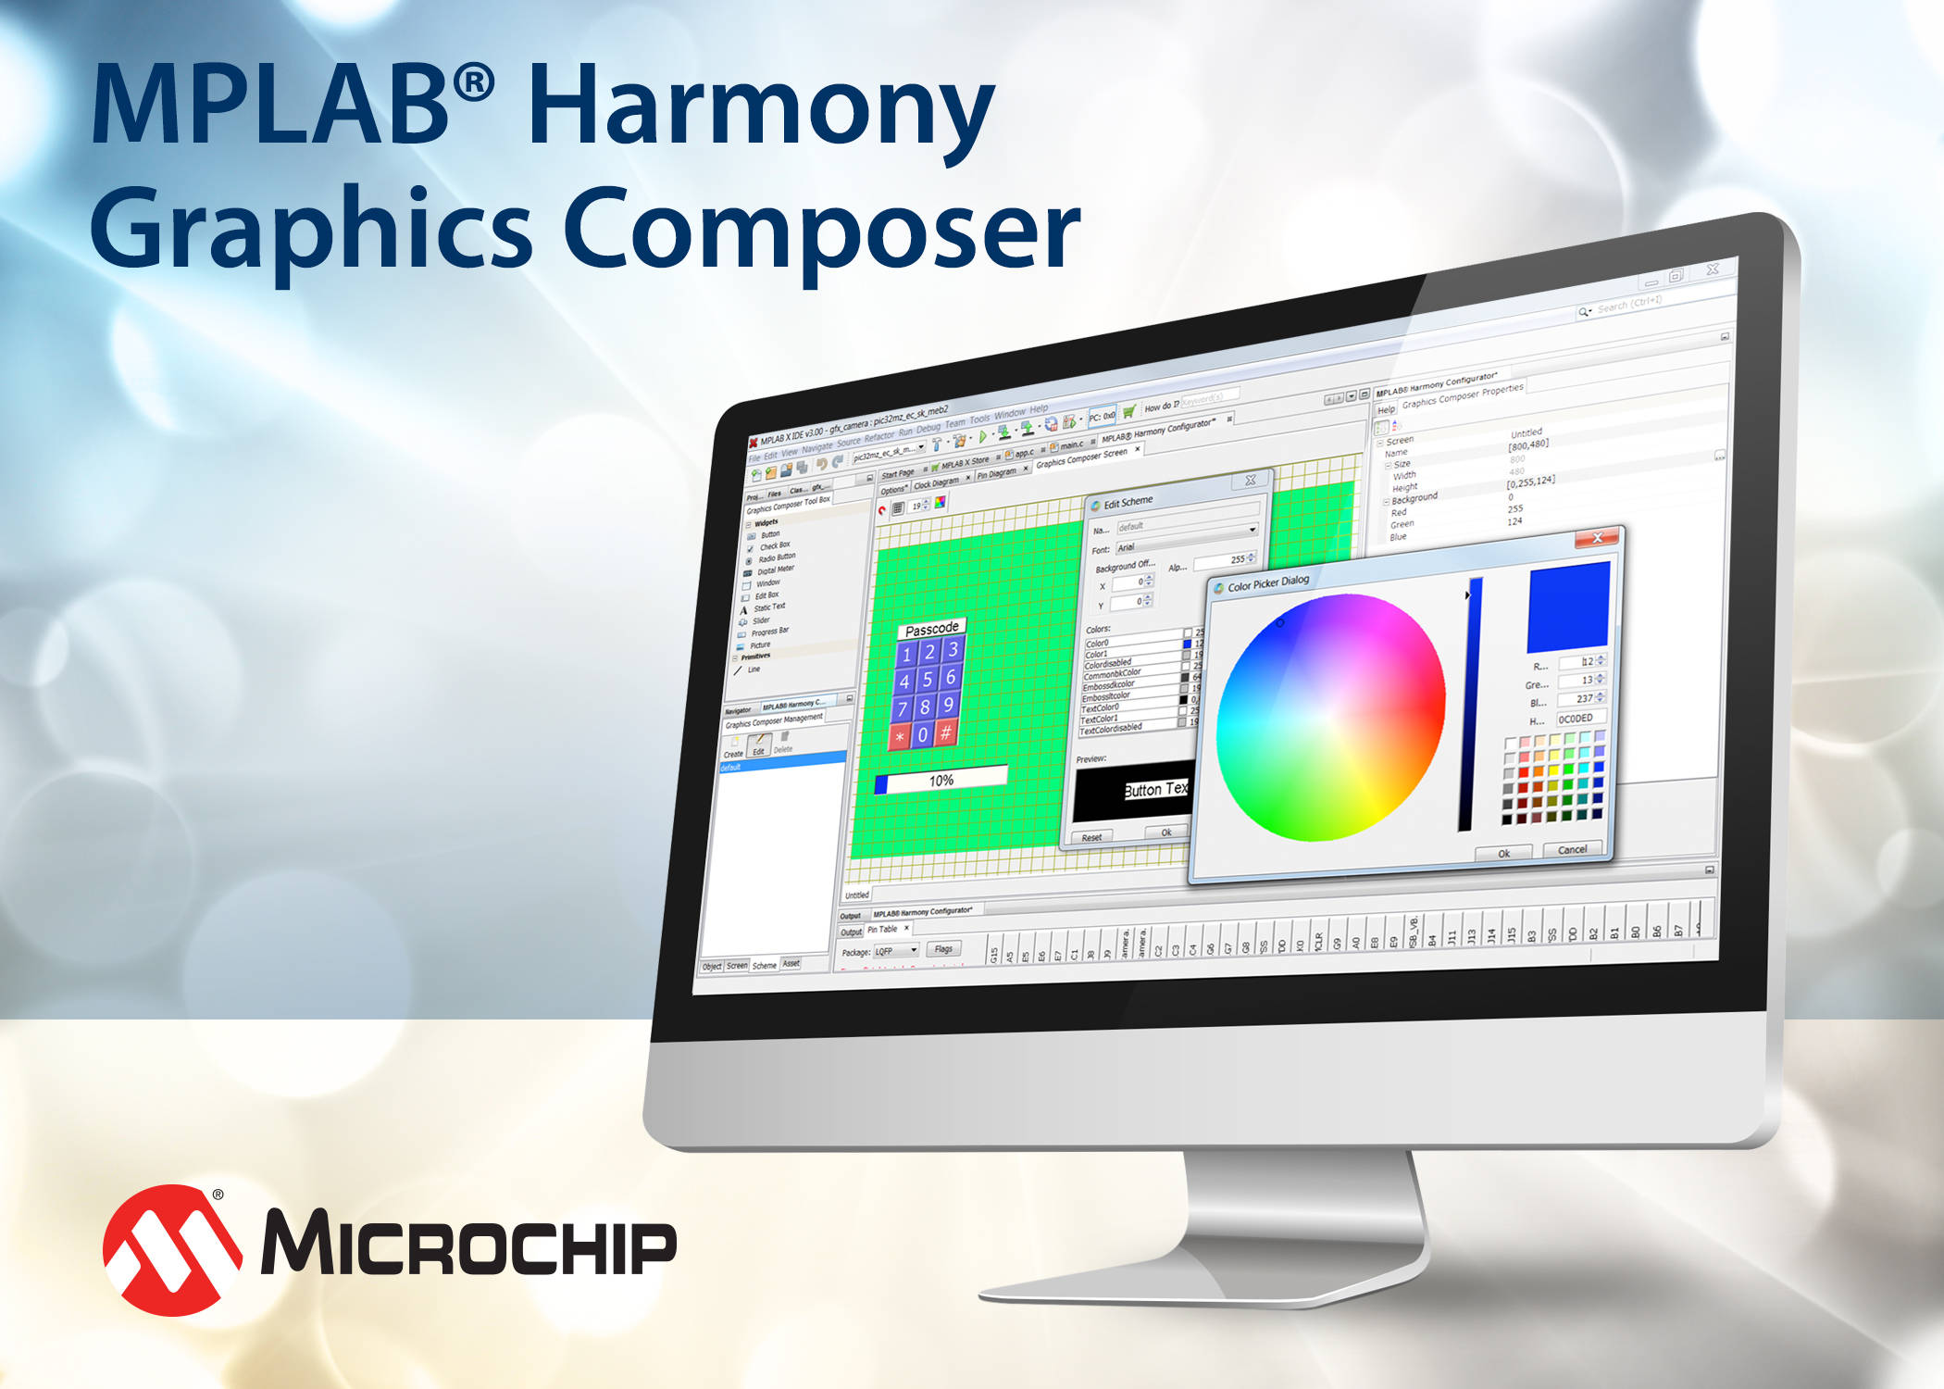
Approach to Implementation
of Device Software

Slide 13
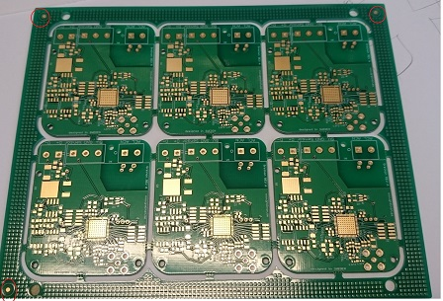

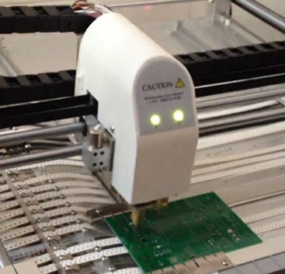
Manufacturing Approach (PCB & Assembly)
Techniques:
Panelization
SMT Components
Fiducials
Component Packaging
Silkscreen
Spacing/Clearance
Single Sided Board
Enables Pick & Place Machine:
Small Device Size
Low Cost
High Reliability
Eliminates Assembly Time

Slide 14
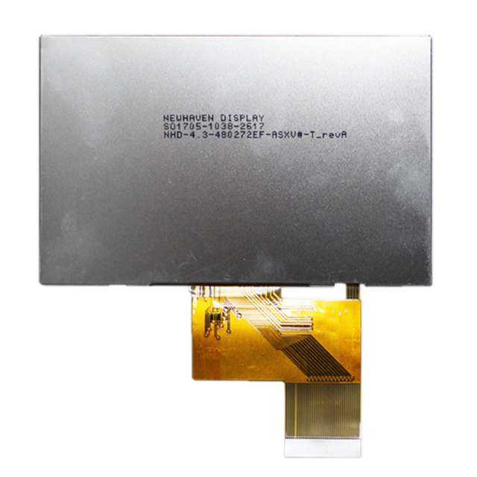
Packaging
3D printing
Mounting the display and PCB
Connector placement
Water resistance

Slide 15
Production Testing
Primarily software based error detection and calibration routines
Hardware errors should be infrequent due to exterior professional assembly
Initial examination should still be completed

Slide 16
Documentation
Operation Manual:
Intended for end user
Operation of GUI
Data export
Device Hardware Configuration
Hardware Documentation:
Intended for development/modification by engineering students
Emphasis on schematic and PCB
Software Documentation
Intended for development/modification by engineering students
Code will be mostly self-documenting
Additional use of Screen casts for MPLAB Harmony Setup

Slide 17
Timeline
11/20/2018 – PCB and BOM ordered
11/30/2018 – Boards assembled
01/09/2019 – Peripheral code and HW documentation completed
02/07/2019 – Finalize boards, BOM, and code
02/25/2019 – Production run and stakeholder testing
04/30/2019 – HW/SW documentation and user guides.
Testing and coding, Manufacturing, packaging, production test, documentation

Slide 18
Questions, Suggestions, & Feedback
Schematic & PCB Layout
Bill of Materials & Component Selection
Device Functionality
Software Organization/Approach
Manufacturing
Testing
Device Packaging
Documentation

Slide 19
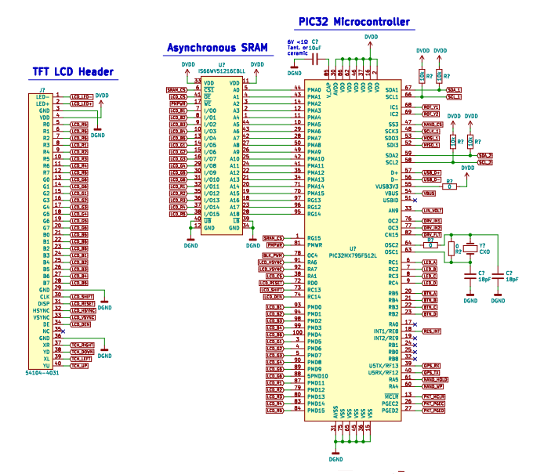
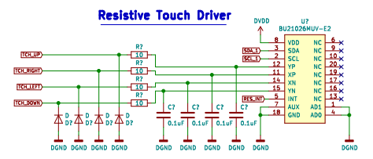
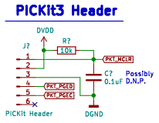
Microcontroller and LCD

Slide 20
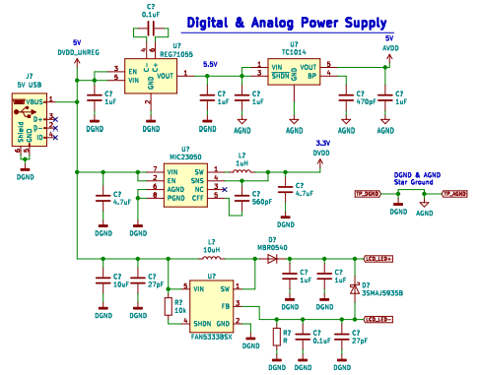
Power Supplies

Slide 21
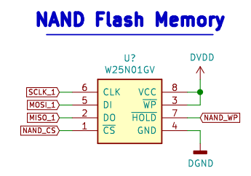
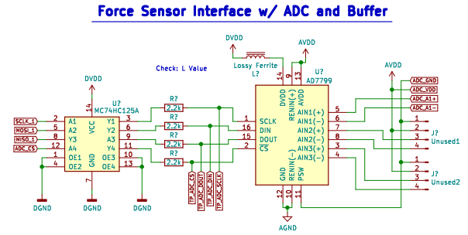
SPI Bus

Slide 22
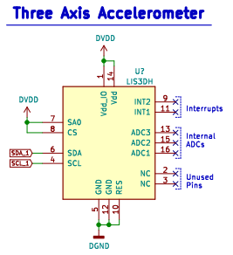
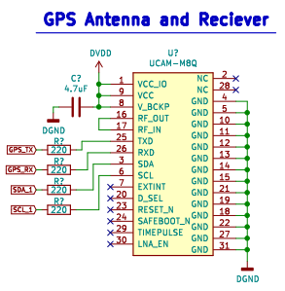
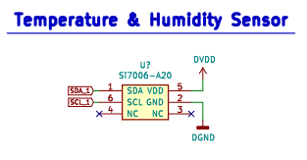
I2C BUS

Slide 23
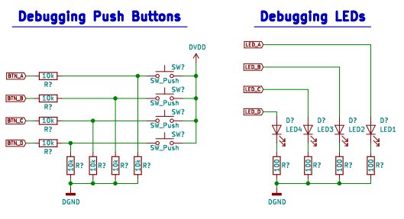
User IO

Slide 24
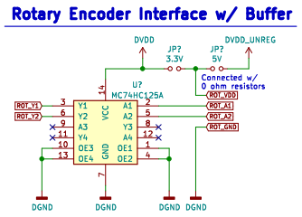
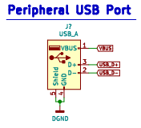
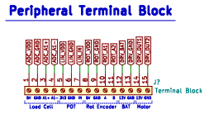
Encoders and USB

